Slide 1
Take It Outdoors 2024 Review

Slide 2
Contents
1
Revenue
2
Popularity
3
Membership
4
GROUP Discount
5
Wednesday Nights
How much money was made from each trip length and day of week?
What trips, boats, days, and time slots were most popular this year?
Did paddlers make the most of their memberships?
Should we make changes to the GROUP discount?
What numbers stand out from Wednesday Night Paddles?

Slide 3
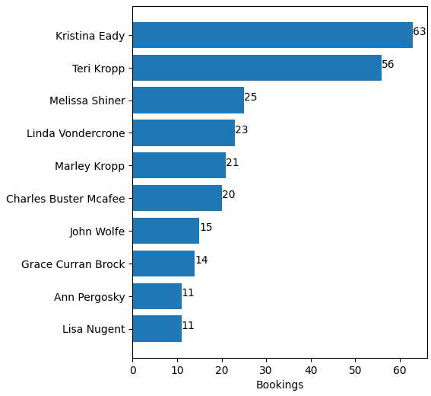
Customers Served
524
Most Frequent Paddlers
unique individuals participated in a TIO paddle this year.

Slide 4
Net Revenue
$52,067.93
All Items/Activities
Excludes Used Gear and Kayak Sale
2023: $57,556.99
All Activities
(Paddling Excursions)
$45,669.24
2023: $56,574.98
Data Date Range: 1/1 - 9/13

Slide 5
Takeaways
Decrease in Revenue may be due to:
Sojourn rentals not appearing in peek in 2024 ($4,856.33 in 2023)
Worse weather/more washouts
Net revenue from 4, 8, 12 mile trips stayed consistent
Other events are what caused the discrepancy

Slide 6
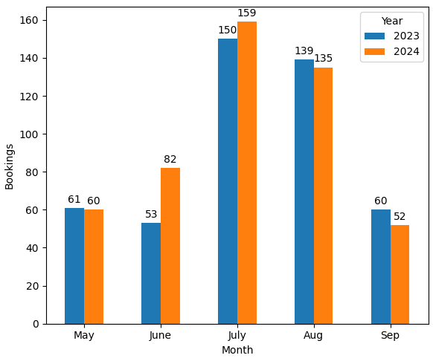
Bookings by Month
Key Takeaways
July is the busiest month, followed by August
Excludes Canceled Bookings and Walk-ups

Slide 7
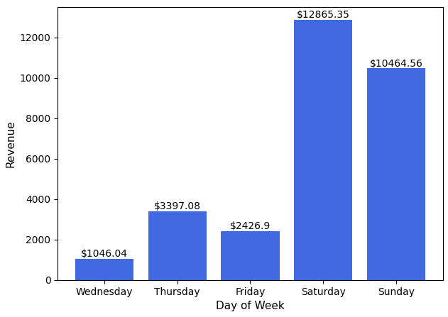
Revenue by Day
77.25%
Only includes 4, 8, 12 mile trips. Excludes walk-ups.
Sat/Sun
of Revenue
Notes:
Revenues DO NOT not include cancelled bookings.

Slide 8
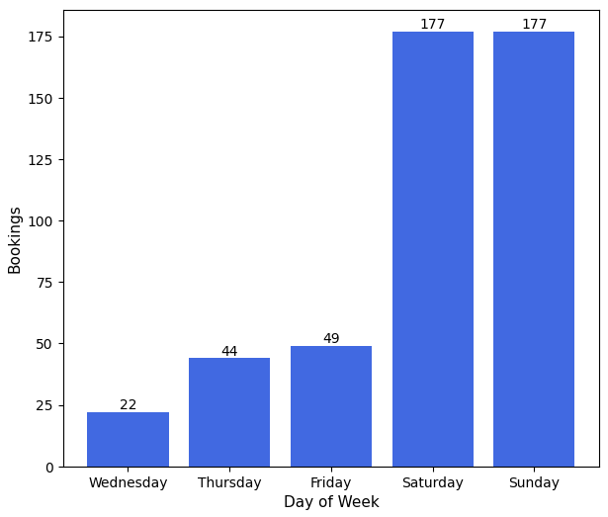
Bookings by Day
75.48%
Only includes 4, 8, 12 mile trips. Excludes walk-ups.
Sat/Sun
of Bookings
Notes:
Count DOES NOT not include cancelled bookings.

Slide 9
Takeaways
Weekdays are rarely busy
Should we try lowering prices or creating programs for weekdays to see if it increases popularity?
Offer weekly events on Thursday/Friday, similar to Wednesday Night Paddle?

Slide 10
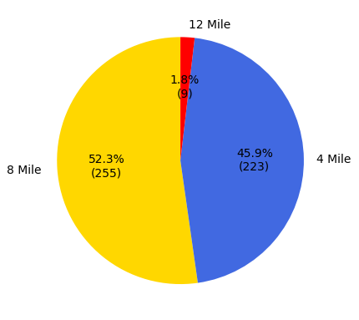
Rental Breakdown by Trip
4 Mile
Net Revenue: $15,104.93
8 Mile
Net Revenue: $18,671.67
12 Mile
Net Revenue: $255.13
Notes:
Net revenue DOES include cancelled bookings (Some cancelled bookings were not fully refunded).
Count DOES NOT not include cancelled bookings.

Slide 11
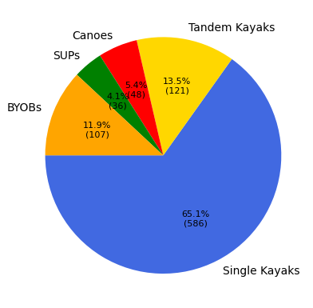
Rental Breakdown by Boat Type
Key Takeaways
Single Kayaks are easily most popular
SUPs are least popular, despite same price as a single kayak
Can we market the SUPs better?
Excludes Canceled Bookings

Slide 12
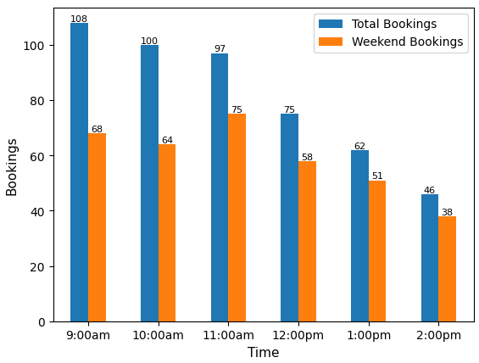
Bookings by Time Slot
Key Takeaways
Earlier times are generally more popular
Bookings generally decrease as the day progresses
Excludes Canceled Bookings and Walk-ups

Slide 13
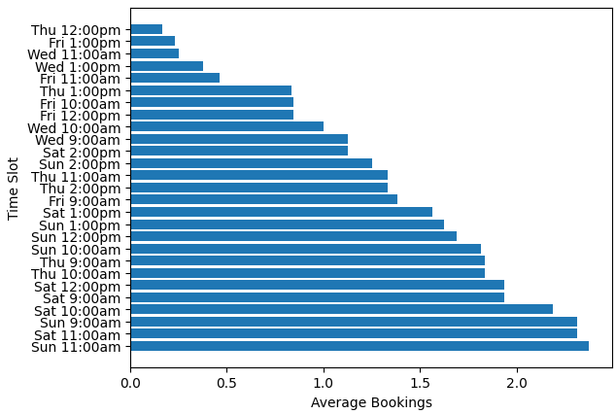
Average Bookings by Day and Time
Key Takeaways
11:00 is peak time on weekends
2:00 is the least popular time overall, even on weekends
Consider replacing 2:00 with an 8:00?
Excludes Canceled Bookings and Walk-ups

Slide 14
Memberships
Key Takeaways
Should we charge more for a membership?
Offer multiple membership options with different limitations
Maximum number of bookings
Specified date range/weekdays only
Unlimited
Teri Kropp
$2170 Discounted
Kristina Eady
$2590 Discounted
Linda Vondercrone
$860 Discounted

Slide 15
GROUP Discount
22
65
$349.24
Key Takeaways
Is GROUP discount even worth having?
If we decide to keep it, it must be made more well-known
Bookings used GROUP discount in 2024
Bookings were eligible to use GROUP but did not
Discounted by GROUP

Slide 16
Wednesday Night Paddles
14
235
71
$2287.08
Key Takeaways
Many paddlers are Wednesday night regulars
Raising the cost by a few dollars is a possibility because of the regulars and the demand
Wednesday Night Paddles
Wednesday Night Paddle spots filled
Unique individuals participated in a Wednesday Night Paddle
Net Revenue

